Slide 1



MS Access
Class VIII
lab 25

Slide 2

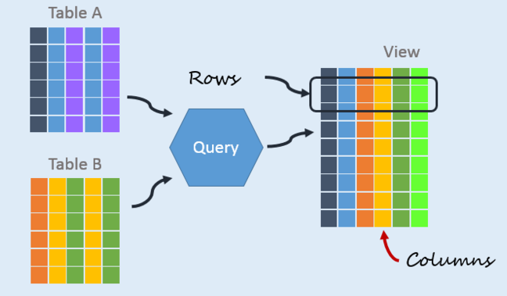
Create Tables
When you create a database, you store your data in tables. Because other database objects depend so heavily on tables

Slide 3
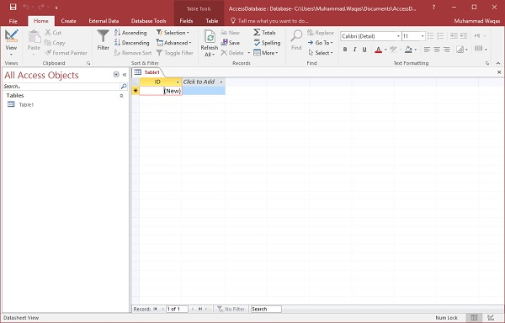
Open Blank Database

Slide 4
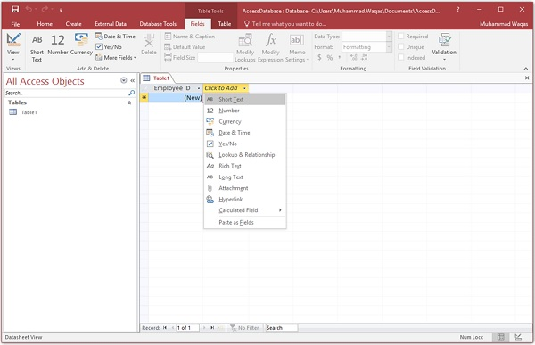
Add More Fields

Slide 5
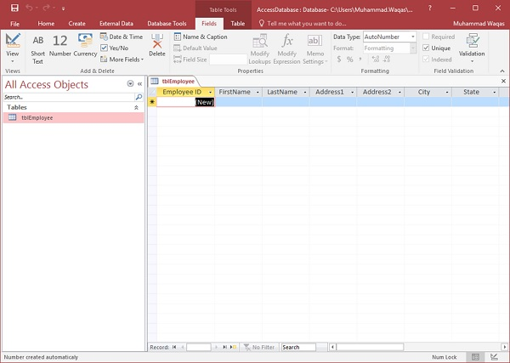
Prefix Stands for Table
Enter the name of your table in the Table Name field. click Ok and you will see your table in the navigation pane

Slide 6
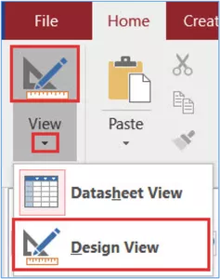
Table Design View
Table design view is used to design a table; if new table in inserted then design view is used to add the required fields in it

Slide 7
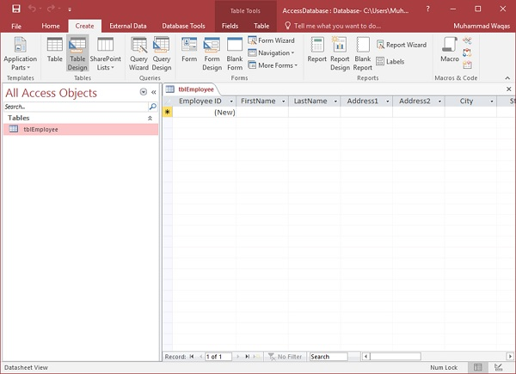
Create Tab

Slide 8
Create Tab

Slide 9
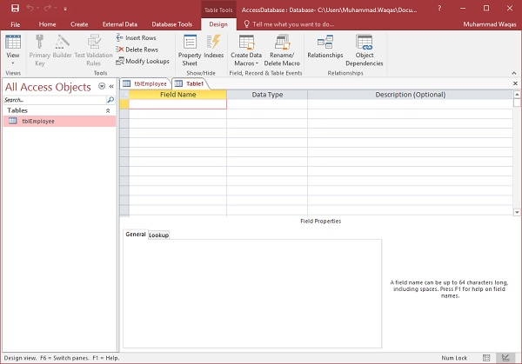
Primary key for the Project

Slide 10
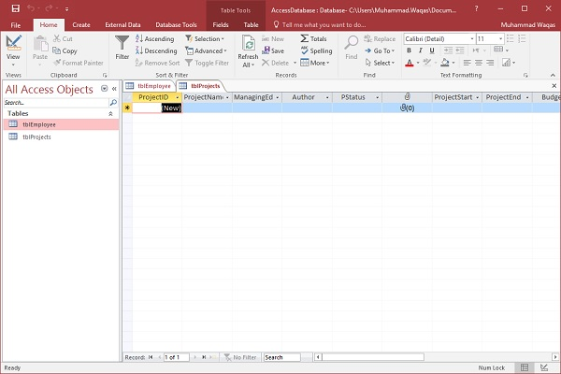
Datasheet View Button

Slide 11



